Slide 1
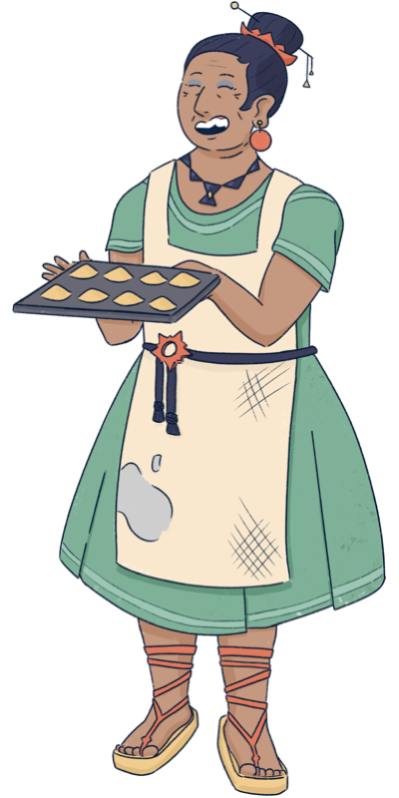
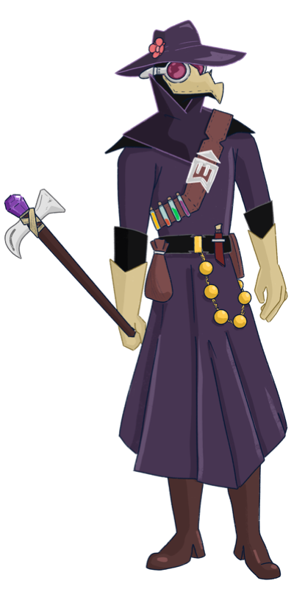
You must be the new doctor! I have been waiting for you…
Sorry ma’am, you must mistake me for my old grandpa.
I am wearing the same outfit, and I have his old manual,
but I have no experience, no way I can help you.
Also, I plan to be in town only for one week,
I do not have time for this…
It is impossible to recognize you, with that mask…
I am sure you are as talented as the old doctor!
Please help me, we have plenty of time today.
And as a reward, I will make you try my new recipe.
I baked delicious broccoli cookies!

Slide 2
How do I even start?
What are all these buttons?
Confirm [hidden]
Appears after you assign a cure to each patient
Help
In case you forget the tutorial info
Tests
Allow you to figure out the symptoms of your patients
Manual
Contains information about diseases
Homepage
Gives you an overview of the patients

Slide 3
Each patient suffers from some disease.
The manual contains one page for each disease… but for now I can read only the first three. It will take time to translate more pages.
Each disease is characterized by a pattern of symptoms. For example, typhoid always gives headache, and never gives running nose.
I need to figure out the symptoms in order to match the right disease.
Once I know the disease, the manual says what is the best treatment.
Manual
The manual contains information about diseases

Slide 4
Figuring out the symptoms seems tricky!
Grandpa taught me to use some tests, for example hit the patient with an hammer to check if they have headache. It is not very elegant, but it works most of the times.
I do not have much experience with these tests, so sometimes the results are off. I will gradually get better by getting more experience.
For now, each test has 75% accuracy. It means that, if the test is positive, there is 75% chance the patient has a symptom, and 25% they do not have it.
Headache
Hit the head with a hammer
Running nose
Put some snails in the nose
Weakness
Place leeches over the body

Slide 5
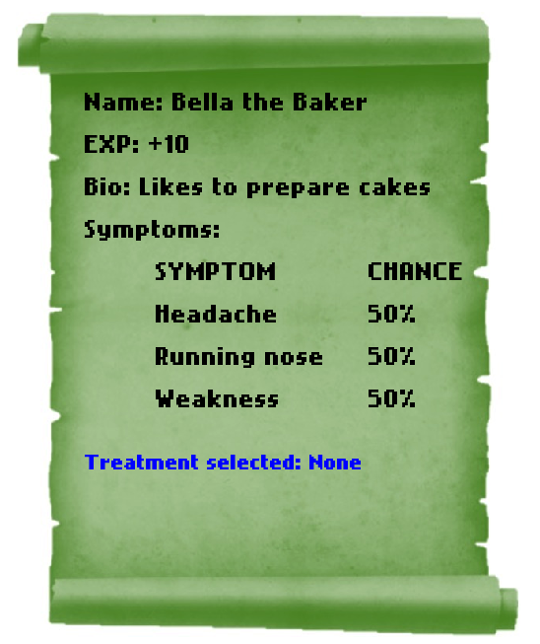
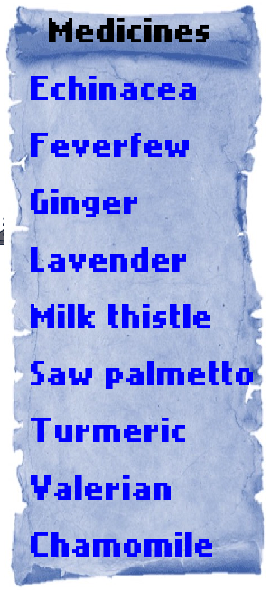
Every time I run a new test, the information is updated in the report of the patient (green scroll).
Initially I do not have any information, so all the symptoms have 50% chance of being there.
100% chance means I am sure there is a symptom
0% chance means I am sure there is NOT a symptom.
I have a fancy abacus that does the math for me and updates the probability based on the test accuracy.
When I have enough information about the symptoms, I can check the manual and select a medicine from the list (blue scroll).

Slide 6
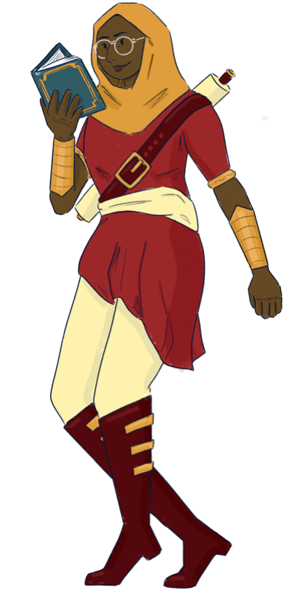
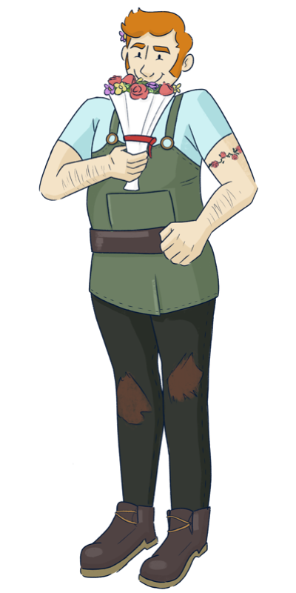
So… you are the “young doctor.”
The village is small, and Bella told everyone about you
(and also about the broccoli cookie, blah!)
I guess you can help me, I found not help in this book…
I guess I am doomed! What a terrible vacation.
I have only a few days left in the village,
I wonder how desperate they are to ask help to me…
Sorry to bother you, but I am also in need for help.
Please, we really need you. Everyone in the village
is happy to help each other, we will not forget this!

Slide 7
I am learning something new every day!
Every time I cure a patient, I get some experience.
With enough experience, I can increase my skill level, and improve the accuracy of the tests.
Soon I will be able to learn about new tests and new diseases to cure…
From now on, I do not have as much time as I would need to test the patients.
Every day I have time only for a limited number of tests.
I will probably check the manual a few times during the day, it will help me to figure out which tests will be useful.

Slide 8
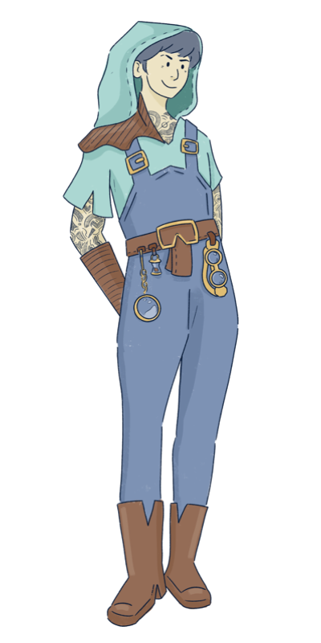
After you helped me the other day, I felt much better.
Then I ate some burned cookies, and here I am again…
You should know me by now, finding the cure will be easy!
It could be something completely different from before!
But yes, it is true it will take less time.
It seems you have time to spare…
In that case, better help me, doctor.
My case might be trickier, but the reward will be higher!

Slide 9
There are so many patients now!
Which of them should I help first?
Old patients
They usually require fewer tests, as you can perfectly observe some symptoms from the beginning of the day
New patients
You can see fewer symptoms in advance, but they give you more experience. High risk, high reward!

Slide 10
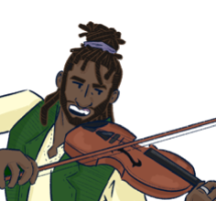
You are something! I heard that people are travelling
from other villages to get your help…
But what is this terrible noise I hear from the forest?
I cannot read!
Good grief, even MORE patients???
This sound is terrifying, what kind of animal is in pain?
It is me, Bob!
I usually travel to spread my music with the world,
but today I am here only to beg for your help.
I will convince you… by playing an original piece!

Slide 11
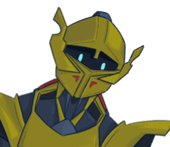
Who am I?
Who are you?
Where am I going?
Where do I come from?
Are you a knight or a Greek philosopher?
I am lost, and I do not remember anything.
Maybe… maybe you can help me?

Slide 12
My memories are back, but I need to rest a few days more before going back to my kingdom. This village seems the perfect place to rest, so quiet…
Definitely not for me! My “relaxing” week is almost over and I have been working all the time (and for free)
Don’t be grumpy, doc!
I can tell you are a completely different person.
You’ve mastered almost all the tricks in that dusty manual…

Slide 13
THANK YOU SO MUCH!!!
We know this is the your last day in town.
Time for the last check-up visits,
and then PARTY TIME!
OK OK, but I still need to pack all my stuff,
I do not have much time!
(They are so needy, but I will miss them)
So don’t waste any time, doc!
My delicious cake in waiting in the oven,
I do not want to burn it (again)

Slide 15
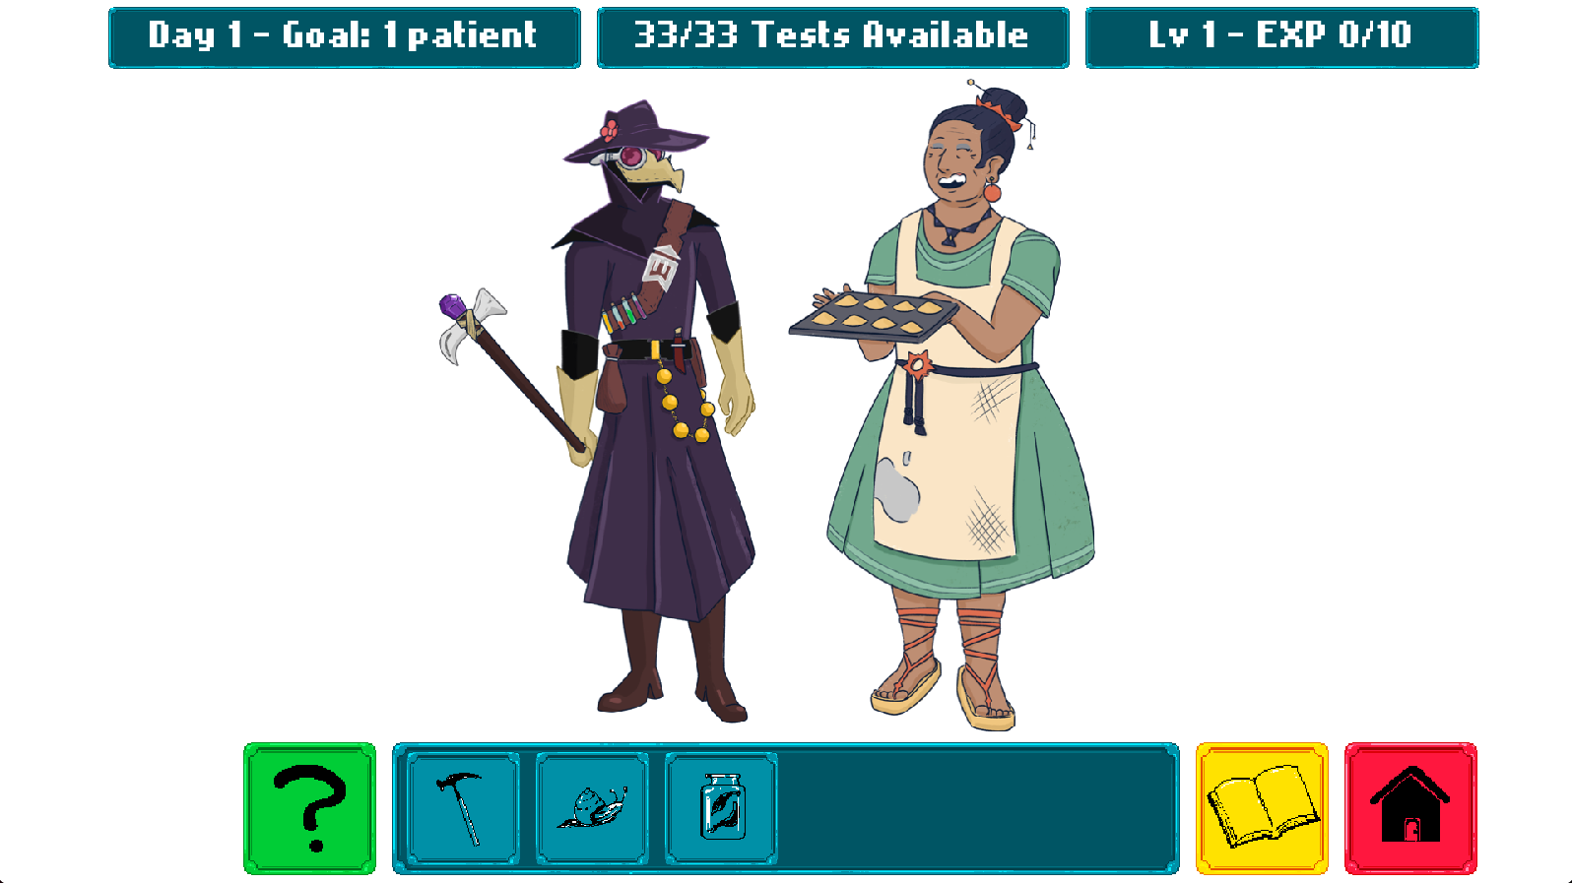

Slide 18

1. Visit the Patients
Each day some villagers seek your help
Sometimes some symptoms are immediately visible, but usually you are not sure
You can run tests (blue icons) to learn more about their symptoms
Click on a patient to read their report (list of symptoms), then click on the test icons to update the report with the new results
Your tests are initially not perfect, you will have the chance to improve them later
You have a limited number of tests available every day
To move to another patient, return to the main screen (red icon)

Slide 19
2. Consult the Manual
Click on the manual (yellow icon) to see the list of known diseases
You unlock more diseases and symptoms during the game
Each disease has a typical pattern of symptoms
Some of them always appear in the sick patients, others never appear, and others might appear with different likelihood (rarely or often)
Consult the manual to decide which tests are most useful for your diagnosis
The manual also contains the correct medicine for each disease
Chamomile has a small chance of cure any disease (it is not very reliable)

Slide 20
3. Cure the Patients
When you have collected enough hints, it’s time to cure you patients
From the report page of a patient, click the Medicines icon (above the villager)
You can choose one medical herb and assign it to the patient
You find the correct treatment for each disease in the manual
After you choose a medicine for each patient, a confirmation button (green) will appear on the bottom-left corner of the screen. Click it to end the day
You will see the report with information about which patients are cured

Slide 21
4. Experience and Days Progression
In order to proceed, you need to cure at least the target number of patients
If you fail, you will restart the day
If you succeed, you also collect experience based on which patient you saved. Each patient has a different experience value
Experience points make you advance to the next level and unlock new skills
You can use the skill points to improve the accuracy of your test
A test with higher accuracy makes fewer mistakes

Slide 22



Slide 26
VISIT THE PATIENTS
Each day some patients seek your help
Sometimes their symptoms are visible, other times you cannot be sure
You can run tests (blue icons) to learn more about their symptoms
Click on a patient to read their report, then click on the test icons to update the report with the new results
Your tests are not perfect, you can improve them during the game
You have a limited number of tests available every day
Click on the red icon (home) to return to the main screen

Slide 27
CONSULT THE MANUAL
Click on the manual (yellow icon) to see the list of known diseases
You unlock more diseases and symptoms during the game
Each disease has a typical pattern of symptoms. Some of them always appear in the sick patients, others never appear, and others might appear with different likelihood
Make sure you consult the manual to decide which tests are most useful for your diagnosis
The manual also contains the suggested treatment for each disease

Slide 28
TREAT THE PATIENTS
When you run out of tests, it’s time to treat you patients
Click on a patient to open the report page
You cannot run tests anymore, but you can assign a treatment to each patient
Click on the right column to assign a medicinal herb
You find the correct treatment for each disease in the manual
After you choose a treatment for each patient, the day is over
You will see the report with information about which patients are healed

Slide 29
EXPERIENCE AND DAYS PROGRESSION
In order to proceed to the next day, you need to save at least the target number of patients
If you fail, you will restart the day
If you succeed, you also collect experience based on which patient you saved. Each patient has a different experience value
Experience points make you advance to the next level and unlock new skills
You can use the skill points to improve the accuracy of your test
A test with higher accuracy makes fewer mistakes

